Slide 1

Smart India Hackathon 2022
Grand Finale - SMIT, Sikkim
Presented by -
Team Kurobulls

Slide 2

Problem Statement
PS ID : LC1076
PS Description : Email Spoofing Detection – Spoofed email with swapped email id(and IP too) can come to any user’s inbox. Suggest a mechanism to filter the spoofed email at server only.
Organization : Ministry of External Affairs (MEA)
Domain Bucket : Blockchain and Cybersecurity

Slide 3
Effect of spoofing attacks
96% of phishing or fraudulent attacks arrive by emails.
66% of malware is installed via malicious email attachments.
Email spoofing and phishing have had a worldwide impact costing an estimated $26 billion since 2016.
Even smart, well-intentioned employees can be tricked into sending money when the request comes from someone they trust—especially an authority figure.
Threat of loss of sensitive information like banking credential, social security number, confidential information passes by government official within organization etc.

Slide 4
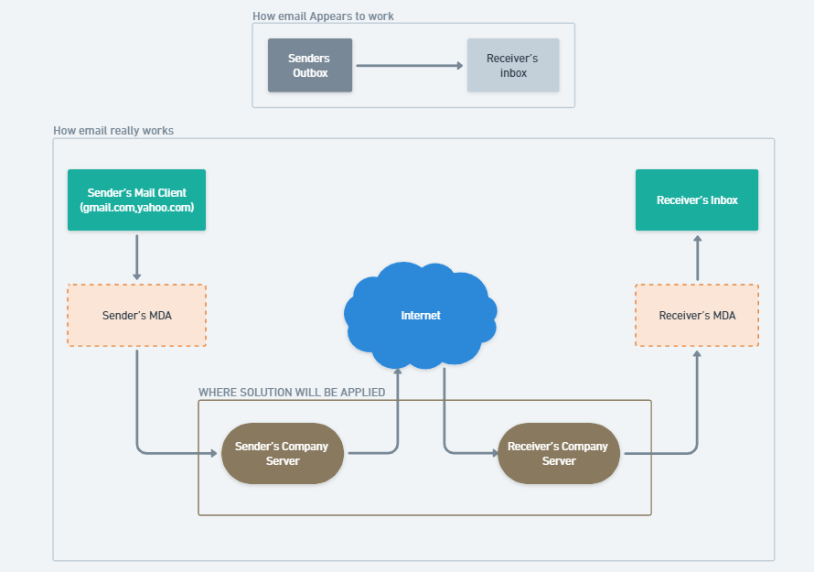
Where the solution will be applied

Slide 5
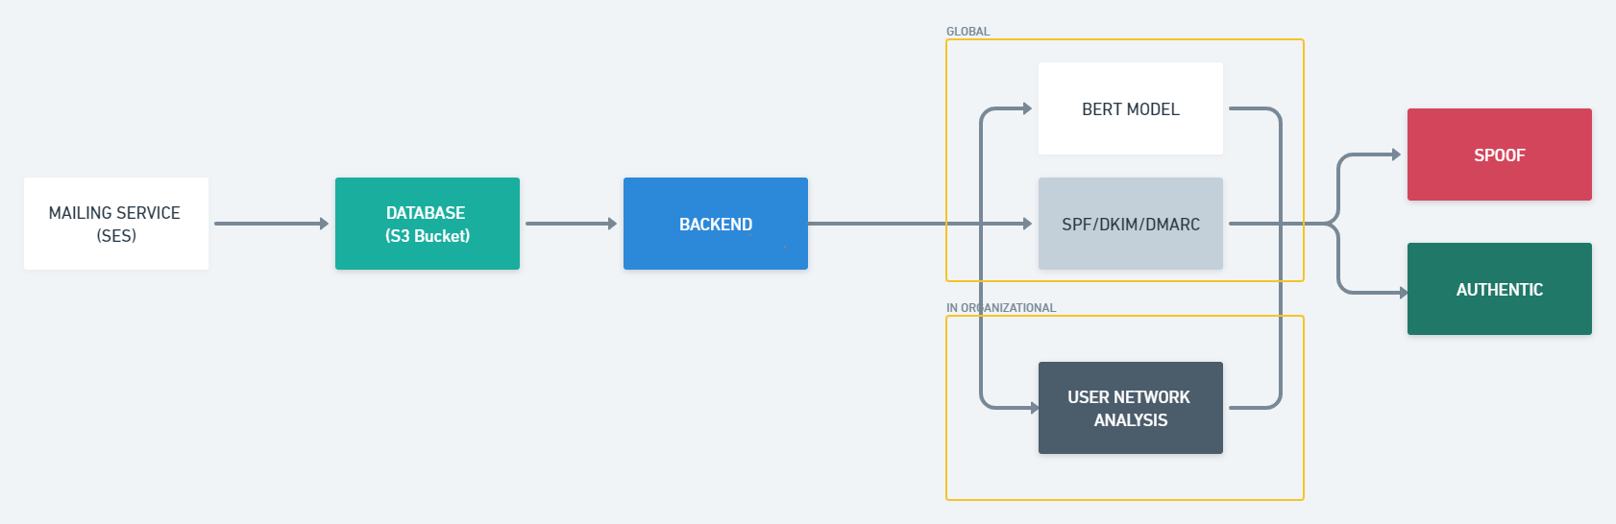
System Architecture

Slide 6
Unique Approach
When we presented our solution to the Ministry of External Affairs (MEA) personnel who created the problem statement, they asked us a question to prevent in-organizational spoofing.
After numerous brainstorming sessions and our diligent search for a solution to this issue, we discovered a highly undeveloped and novel concept that we are calling User Network Analysis.
“Simply put, it determines the relevance score between two users who may be connected directly, indirectly, or not at all.”

Slide 7
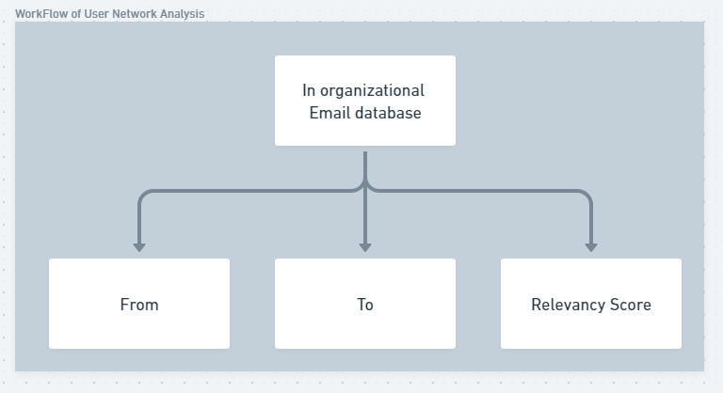
User Network Analysis (UNA)
Working of the model:

Slide 8
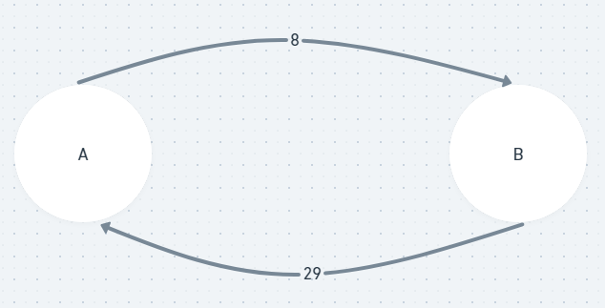
Finding the relevancy between A and B
Inputs: U1, U2, U2 received, U2 sent
Formulas framed:
SR Ratio = U2 Received/U2 Sent
RS Ratio = U2 Sent/U2 Received
Sum = SR Ratio + RS Ratio
Relevancy Score = ((0.7*Received + 0.3*Sent)/Sum)
Norm_Rev is rescaled value of Relevancy Score between 0-1 for better understanding.
Norm_Rev = (xi - min(x) / (max(x) - min(x)) where x is the set of Relevancy Score
Result:
* The threshold point for two users will be Norm_Rev < 0.03

Slide 9
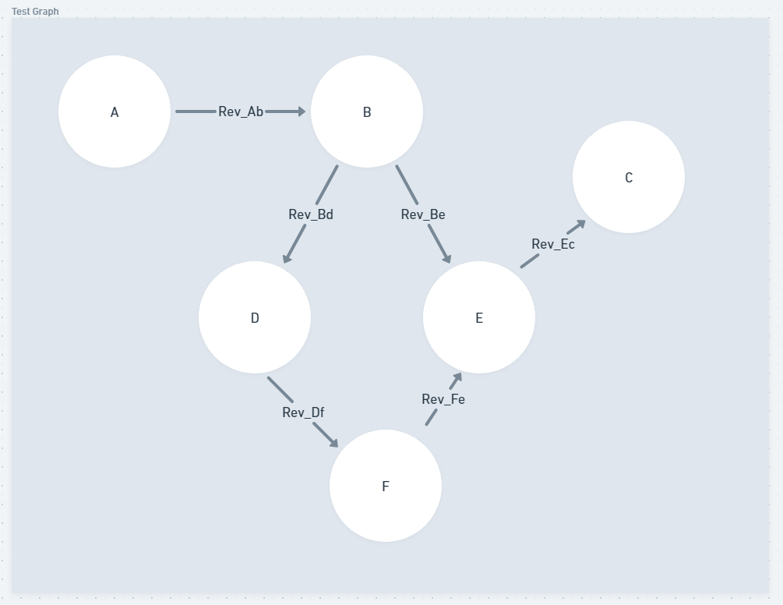
To find relevance between users which are not directly connected.
Indirect connection A - C
Number of Nodes = i
Longest path from A to C: A-B-D-F-E-C
Length between nodes → Relevance Score between them
Total Length or Rev_Total = Rev_Ab + Rev_Bd + Rev_Df + Rev_Fe + Rev_Ec
Maximum Length = 1 * (i-1)

Slide 10
Method to determine whether the email is spoofed or authentic:
If Rev_Total > 60% * (Maximum Length) then it is authentic
If Rev_Total <= 60% * (Maximum Length) then the email is spoofed.
To support the formula and how the percentages are taken, we did hypothesis testing on the relevancy score.
Conclusion:
This is a purely mathematical based approach.

Slide 11
Scenarios
U1 Sent Less, U2 Sent High (Professor → Students)
U1 Sent High, U2 Sent Less (Head of Finance Dept. → Employee)
No Connection at all (No email exchange ever)

Slide 12
BERT Model
Stands for Bidirectional Encoder Representations from Transformers.
A Deep Learning model based on transformers, where each output is connected to each input element, and the weights between them are dynamically calculated based on their connection (In NLP it is called as Attention).
Working :
We have our dataset having the labels - "genuine" and "spoofed."
Based on the text in subject(from header), we are making a prediction.
Sometimes the subject contains information that could be a potential threat, thus we must first separate the subject from the header before performing the basic text classification technique.

Slide 13

BERT: Why Use It?

Slide 14
Please provide your insightful comments.

